Slide 1



G H RAISONI COLLEGE OF ENGINEERING AND MANAGEMENT
(Approved by AICTE, New Delhi and Recognized by DTE, Maharashtra)
An Autonomous Institute Affiliated to Rashtrasant Tukadoji Maharaj Nagpur University, Nagpur
Accredited by NAAC with A+ Grade
Department of Artificial Intelligence
Project Quality Assurance Initiative 2024-25
On
Deep Learning-Based Analysis of Vertebrae X-ray Images
Guide: Co-Guide:
Dr. Sharda Chhabria Dr. V.C Shelgaonkar
Associate Professor Orthopedist (IGMC Nagpur)
Name of Projectees
Vidit Singh Vikrant Patil
Pranay Nakhale Vibudh Mesharam
Vedant Dhoble Punarv Patidar
Session 2024-2025

Slide 2
Contents
Introduction
Literature Survey
Problem Statement
Objective of Project
Methodology
Implementation
Work done
Innovative work (If any)
Results & Discussion
Conclusion & Future Scope
Publication / Presentation / Project Competition
References

Slide 3
Introduction
Scoliosis and Spondylolisthesis are two major diseases related to vertebral column.
Scoliosis: It is a medical condition characterized by an abnormal lateral curvature of the spine. The curvature can be “S” or “C” shaped.
Spondylolisthesis: It is a condition where one vertebra slips forward over the bone below it, leading to potential misalignment and instability of the spine.
2. These conditions can be detected through methods such as :
Physical Examination: Doctors check for signs of scoliosis by observing the symmetry of the shoulders, hips, and ribcage.
X-rays: Used to confirm the diagnosis and determine the severity of the curvature
MRI and CT Scans: Used to provide more detailed images of the bones, muscles, and nerves, especially if surgery is being considered.
3. Drawbacks of Current Diagnostic Methods :
Physical Examination relies heavily on the doctor's experience and expertise, leading to potential variability in diagnosis.
X-rays provide two-dimensional images, which can limit the ability to fully understand complex spinal conditions.
MRI & CT Scans are more expensive than X-Rays, making it less accessible for routine checks .

Slide 4
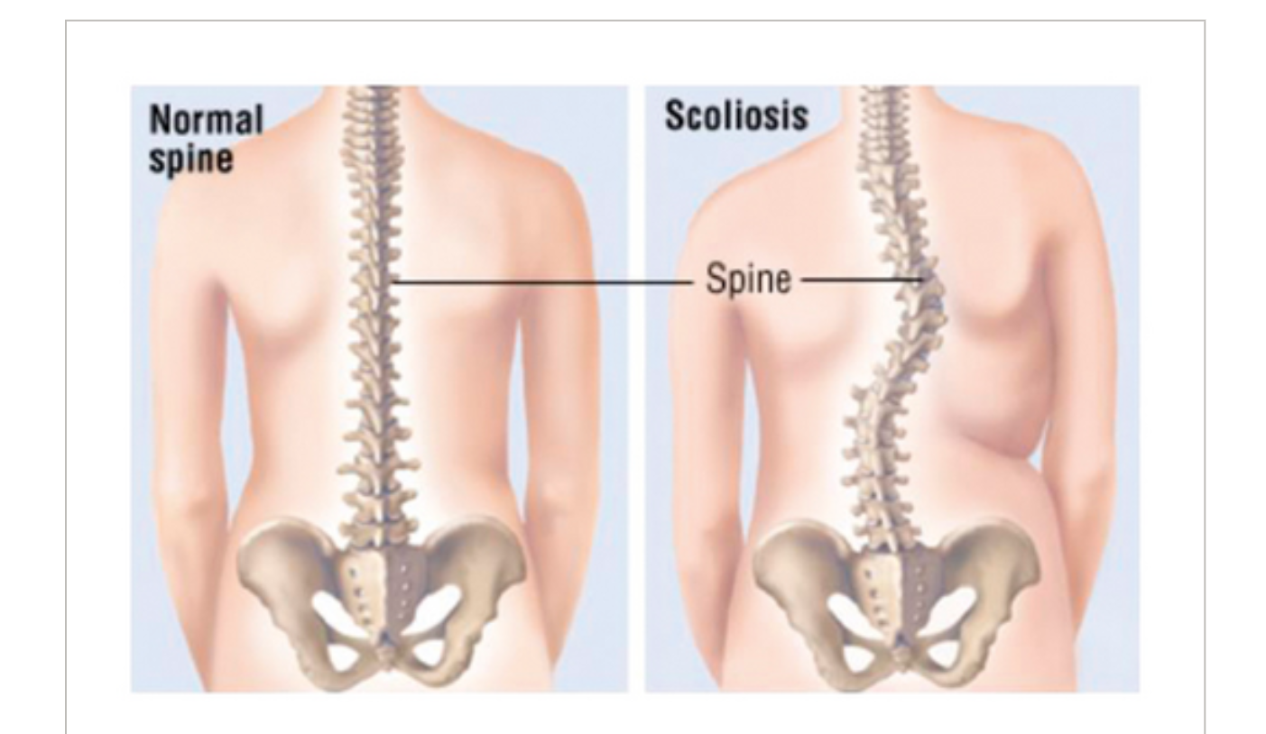
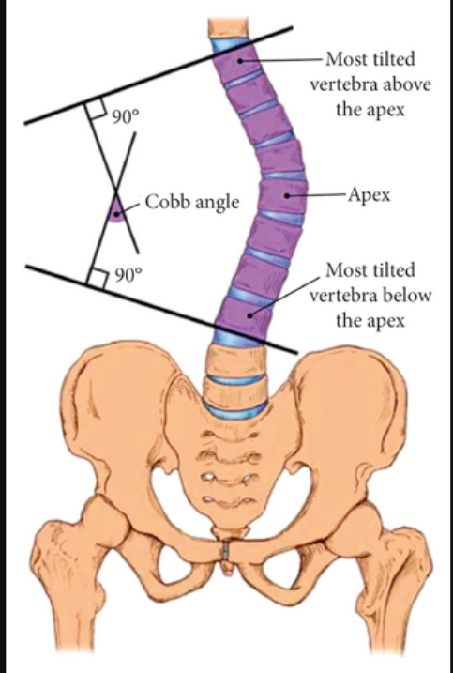
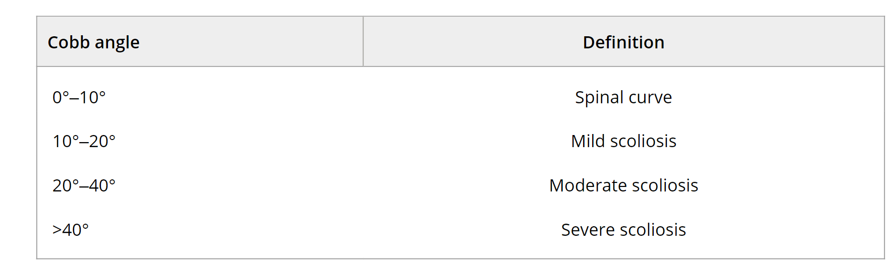
Introduction

Slide 5
Literature Survey
Sr. No. | Paper Title and its Author | Details of Publication | Findings
1 | Shannon entropy and fuzzy C-means weighting for AI-based diagnosis of vertebral column diseases Alafeef M, Fraiwan M, Alkhalaf H, Audat Z | Journal of Ambient Intelligence and Humanized Computing. 2019;11(6):2557–2566. | Raw X-ray data from 422 subjects were processed to weight vertebral features, which were classified using an artificial neural network, achieving 99.5% accuracy.
2 | Supervised and unsupervised learning to classify scoliosis and healthy subjects based on non-invasive raster stereography analysis Colombo T, Mangone M, Agostini F, Bernetti A, Paoloni M, Santilli V, et al. | Department of Computer, Control and Management Engineering Antonio Ruberti, Sapienza University of Rome, Rome, Italy | This study classified scoliosis versus healthy patients using non-invasive Video-raster-stereography. supervised learning (SVM and Deep Networks) achieved around 85% accuracy
3 | Cobb Angle Measurement of Spine from X-Ray Images Using Convolutional Neural Network Ming- Huwi Horng, Chan-Pang Kuok, Min-Jun Fu, Chii-Jen Lin, Yung- Nien Sun | Computational and Mathematical Methods in Medicine. 2019;2019:1–18. pmid:30996731 | Automated Computer measurement system to measure Cobb Angle using deep learning. Residual U-Net achieved the highest DSC of 0.951
4 | A deep learning algorithm for automated measurement of vertebral body compression from X‑ray images Jae Won Seo, Sang Heon Lim, Jin Gyo Jeong, Young Jae Kim, Kwang Gi Kim1 | In: 2017 IEEE Conference on Computer Vision and Pattern Recognition (CVPR); 2017. p. 2261–2269 | DenseNet-201 is 201 layers deep with an image input size of [224 224 3]. The model represents a big jump in the number of layers compared to others
5
6

Slide 6
Problem Statement
1) Proposed Solution: To address these limitations, we propose the development of a deep learning-based model using Convolutional Neural Networks (CNN) for the automated classification of vertebrae X-ray images into three categories: Normal, Scoliosis, and Spondylolisthesis. This model aims to:
Improve Diagnostic Accuracy: By identifying subtle patterns in X-ray images that might be missed by human interpretation.
Enhance Efficiency: Automate the classification process to provide rapid and reliable diagnoses.
Ensure Consistency: Deliver objective and consistent analysis, reducing the variability associated with human interpretation.
Increase Accessibility: Offer a scalable solution that can be deployed in various healthcare settings, including those with limited access to specialized radiologists.
2) Through this project , we propose the use of deep learning techniques on X-Ray image which may be used as an alternative to MRI & CT Scan.
3) The study summarizes and compares customize deep learning algorithm with – DenseNet-201 model on a X-Ray dataset of vertebrae images.
4) The dataset, collected from 338 subjects at King Abdullah University Hospital, Jordan, consists of 71 normal cases (40 females, 31 males), 188 scoliosis cases (151 females, 37 males), and 79 spondylolisthesis cases (49 females, 30 males).

Slide 7
Justifications for Selecting the Title
1) Relevance to Healthcare:
The title addresses significant and prevalent spinal conditions, Scoliosis and Spondylolisthesis, which have substantial impacts on patients' quality of life.
Early and accurate diagnosis of these conditions is crucial for effective treatment and management.
2) Addressing Limitations of Current Methods:
The project aims to overcome the drawbacks of traditional diagnostic methods, such as subjectivity, radiation exposure, high costs, and limited accessibility.
By providing a consistent and objective analysis, the model can reduce diagnostic variability and improve overall accuracy.
3) Technological Innovation:
Leveraging advanced deep learning techniques to automate the classification of vertebrae X-ray images represents a cutting-edge approach in medical diagnostics.
This project contributes to the growing field of medical AI, showcasing the potential of deep learning in improving healthcare outcomes.

Slide 8
Objectives of the Project
Data Preparation:
The data used in the model is collected from sources like Kaggle. The data consisted of 338 vertebrae X-ray images of males and females.
Later , the data will be cleaned and annotated .
Next , the data will be analysed, (we can also resize the dimensions of the image based on the requirements.)
Data Augmentation can be performed if needed.
2) Image Processing:
The process of obtaining and modifying features from input photos to enable precise object detection is referred to as feature construction.(deep neural network will be used to do this)
Using a sequence of convolutional layers, the network receives an image input and processes it to extract even more sophisticated characteristics.
3) Image Classification Task :
Finally the input images will be classified into 3 categories that are :
Normal
Scoliosis
Spondylolisthesis

Slide 9
Work Done (Till date)
Data Collection : X-ray images were collected locally at King Abdullah University Hospital, Jordan University of Science and Technology. The dataset included 338 subjects (240 females, 98 males)
Literature Survey : Findings related use case of DL and various pre-trained models were studied. ML & DL techniques were compared for better results.
Data Preprocessing steps :
Image Normalization
Data Augmentation
Splitting Dataset for Training and Validation
Image Grayscale Conversion
Image Resizing
Batch Processing

Slide 10
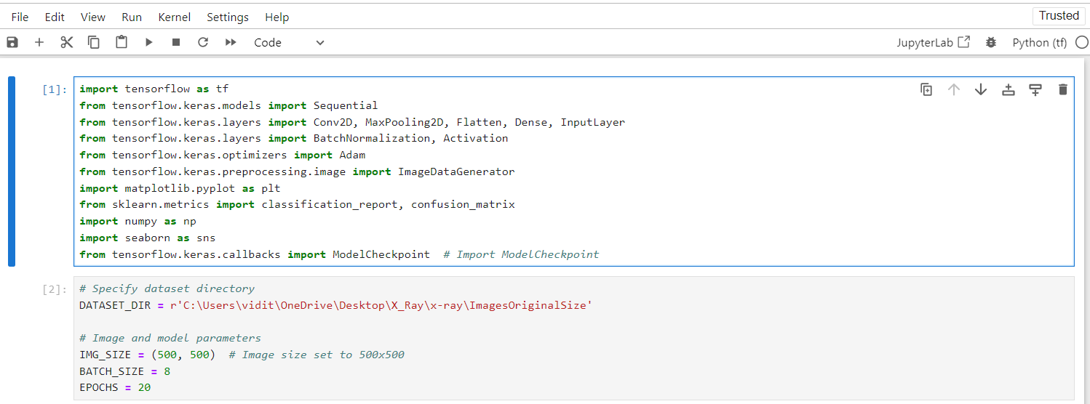
Work Done (Till date)
Step by Step Breakdown of code
Step-1 : Importing Libraries

Slide 11
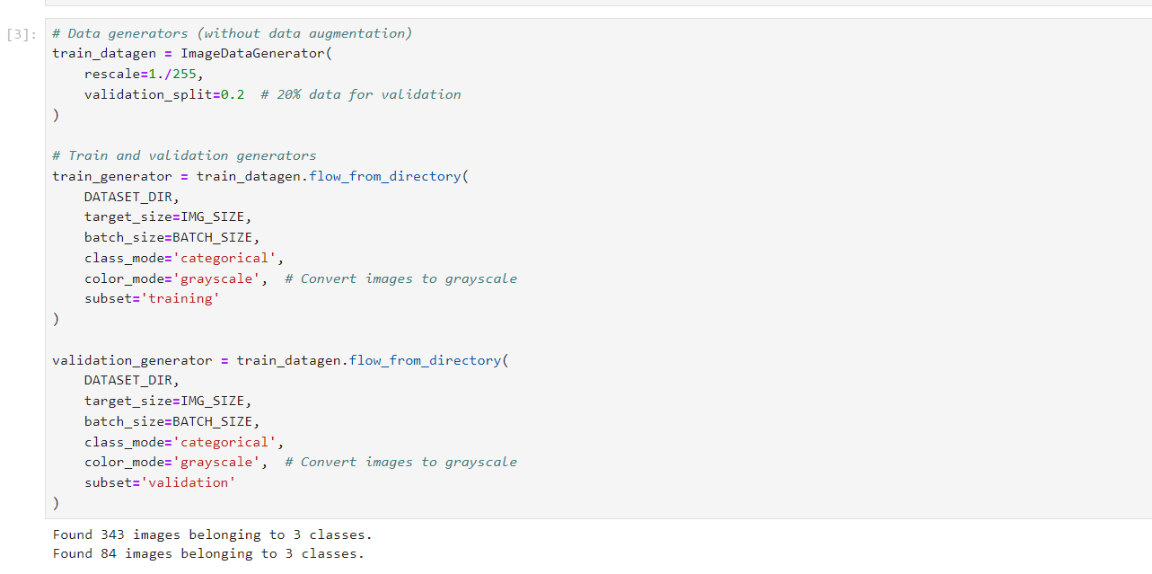
Work Done (Till date)
Step by Step Breakdown of code
Step-2 : Create Train and Validation Generators

Slide 12
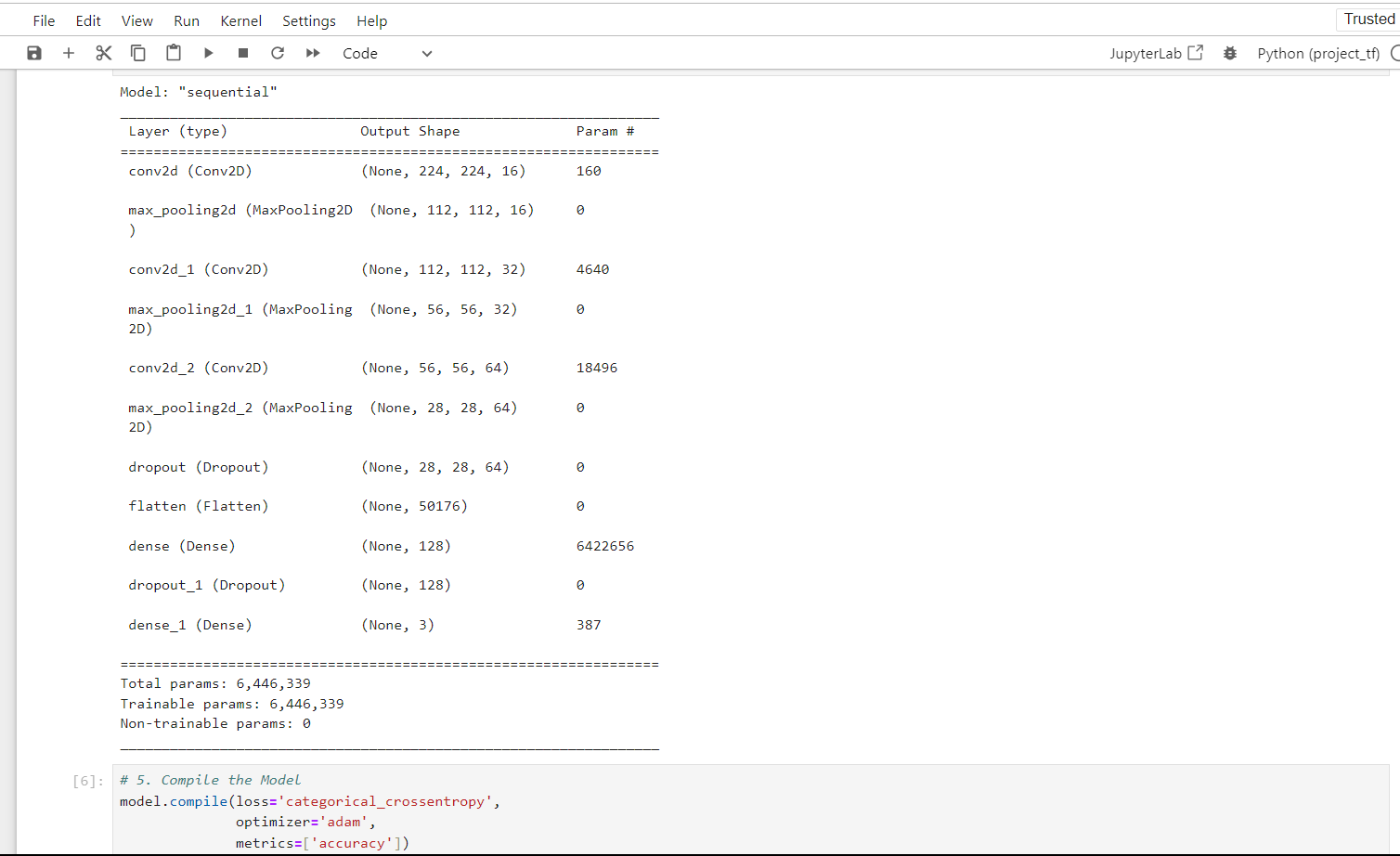
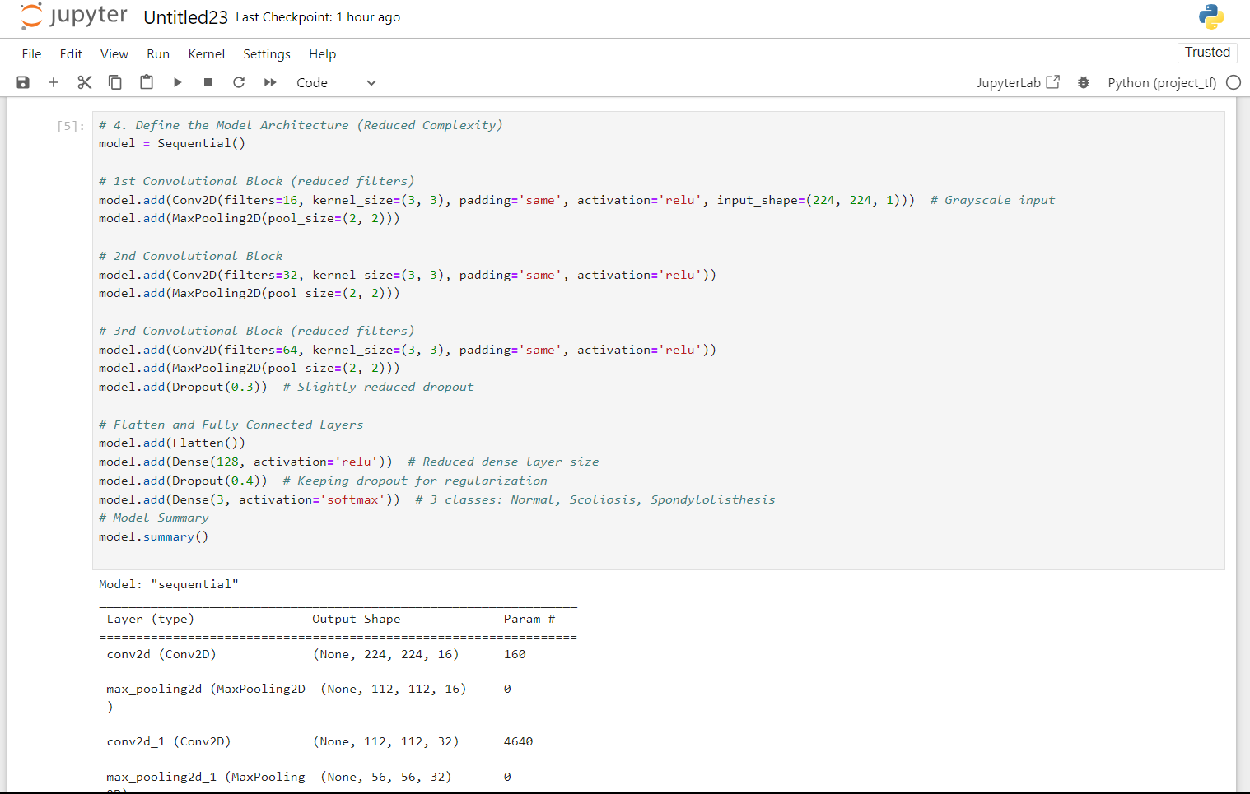
Work Done (Till date)
Step by Step Breakdown of code
Step-3 : Creating Model Architecture

Slide 13
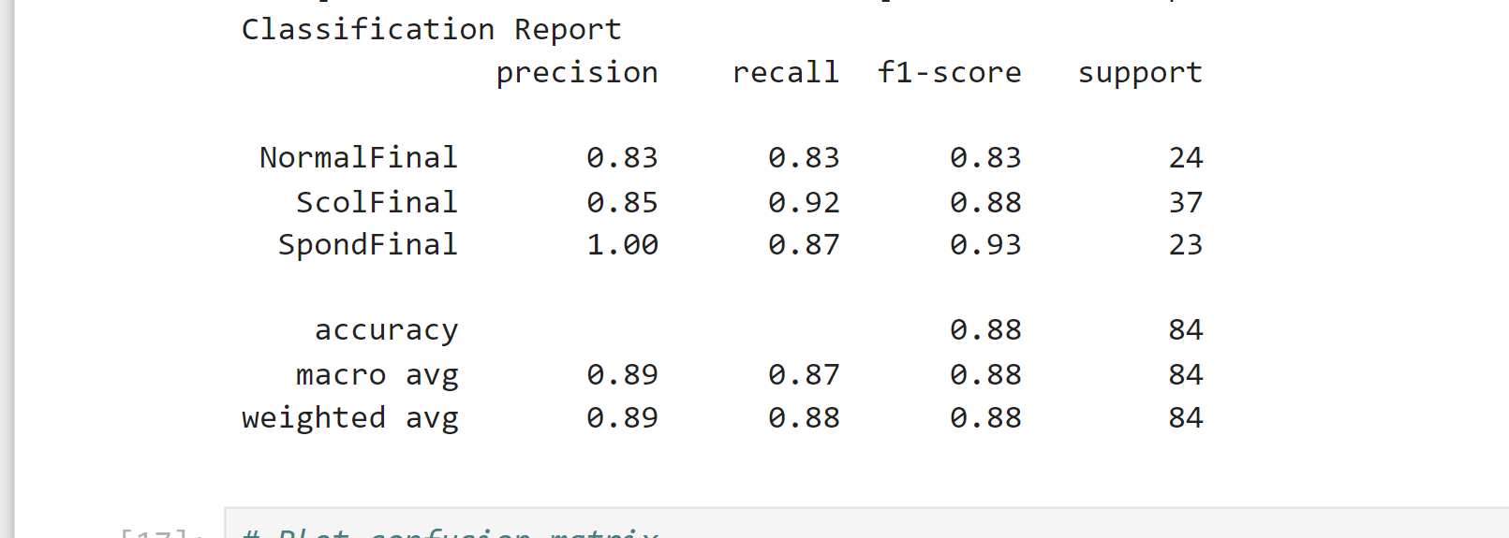
Work Done (Till date)
Step by Step Breakdown of code
Step-4 : Classification Report

Slide 14
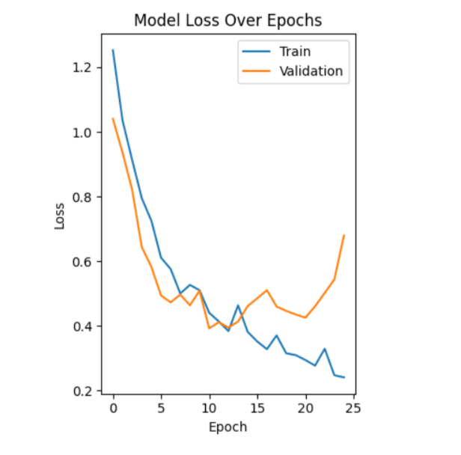
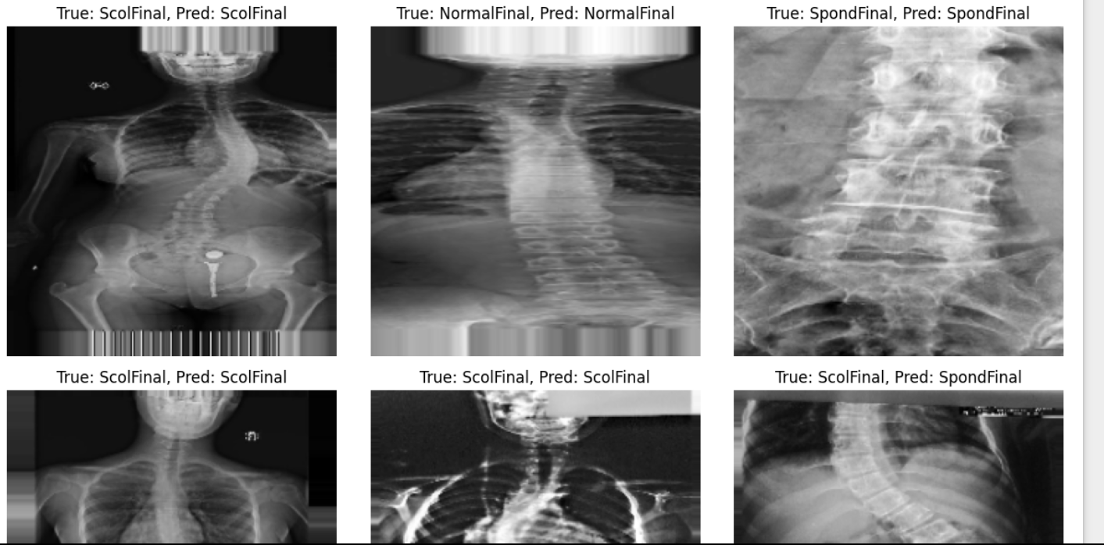
Work Done (Till date)
Step by Step Breakdown of code
Step-5 : Model Loss Over Epochs
Step-5 : Model Loss Over Epochs

Slide 15
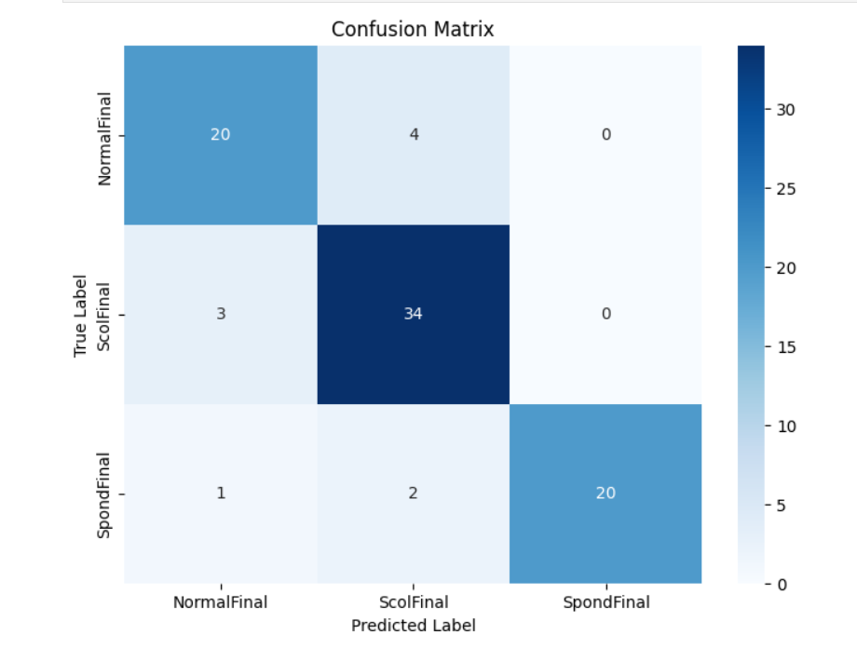
Work Done (Till date)
Step by Step Breakdown of code
Step-6 : Confusion Matrix

Slide 16
Innovative Work ( if any)
Automated Diagnostic System
Custom CNN model designed specifically for vertebrae X-rays.
Achieves 88% validation accuracy with minimal human intervention.
Improved Precision:
100% precision for diagnosing spondylolisthesis.
85% precision for scoliosis.
Elimination of Manual Feature Extraction:
Replaces traditional methods like Cobb angle measurement.
Reduces human error and accelerates the diagnostic process.
Faster and More Accurate Diagnosis:
Real-time classification into Normal, Scoliosis, and Spondylolisthesis categories.

Slide 17
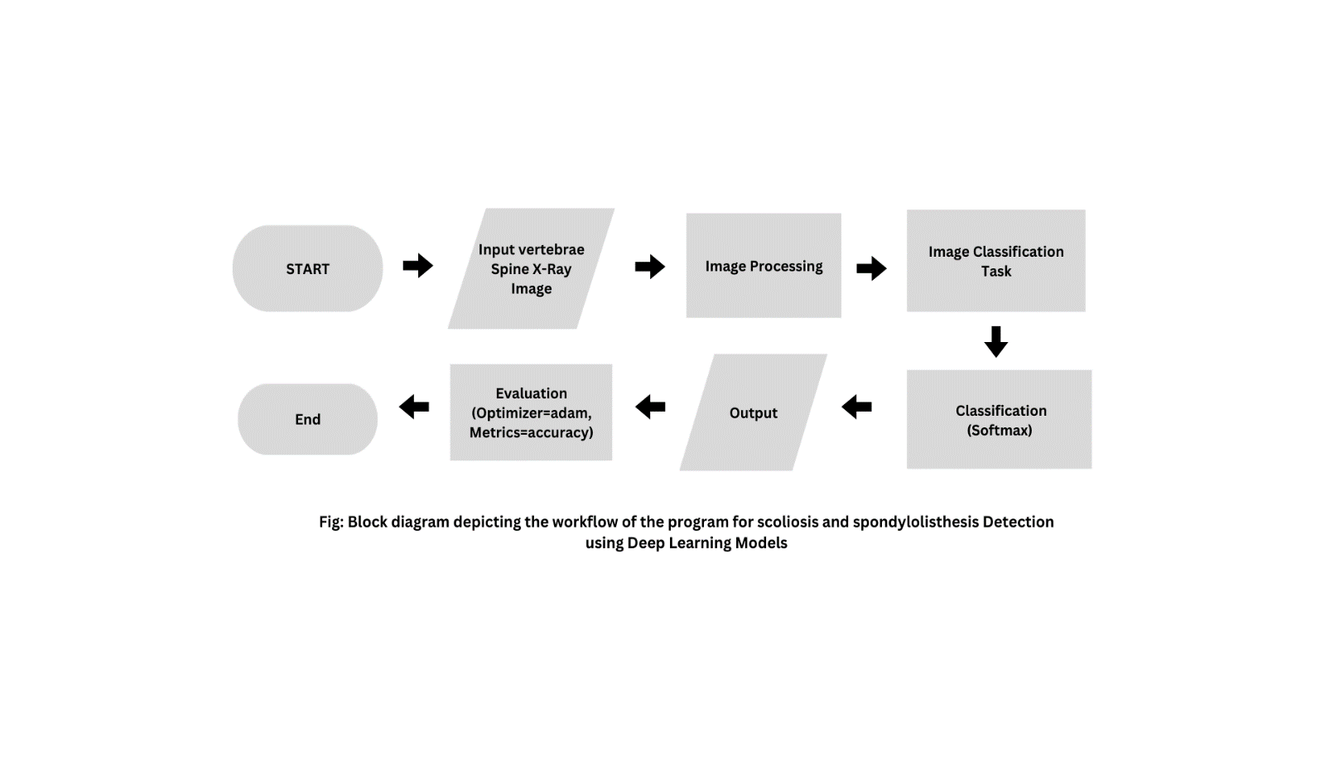
Expected Result
Block Diagram of Expected Result:

Slide 18
Conclusion
Developed a deep learning model to classify vertebrae X-ray images into Normal, Scoliosis, and Spondylolisthesis.
Achieved an overall accuracy of 88%, with high precision and recall across all categories.
The model excelled in identifying Spondylolisthesis, showcasing its diagnostic accuracy.
Demonstrated potential to enhance radiologists' decision-making and improve patient care.
Future improvements include refining the model, expanding data diversity, and integrating it into clinical workflows for real-time analysis.
The study paves the way for AI-based advancements in medical imaging and diagnosis.

Slide 19
References
List of papers/books/websites etc refer for project
Online journals with a DOI (Digital Object Identifier)
Berthonnaud, E., Dimnet, J., Roussouly, P. & Labelle, H. (2005). 'Analysis of the sagittal balance of the spine and pelvis using shape and orientation parameters', Journal of Spinal Disorders & Techniques, 18(1):40â€“47.
Online journals without a DOI
The American Academy of Orthopedic Surgeons. Spondylolysis and Spondylolisthesis; 2020. Available from: https://orthoinfo.aaos.org/en/diseases--conditions/spondylolysis-and-spondylolisthesis [cited 2022 January 15].
Online abstracts
Kokabu T, Kanai S, Kawakami N, Uno K, Kotani T, Suzuki T, et al. An algorithm for using deep learning convolutional neural networks with three dimensional depth sensor imaging in scoliosis detection. The Spine Journal. 2021;21(6):980–987. pmid:33540125

Slide 20
References
List of papers/books/websites etc refer for project
Journals
Alafeef M, Fraiwan M, Alkhalaf H, Audat Z. Shannon entropy and fuzzy C-means weighting for AI-based diagnosis of vertebral column diseases. Journal of Ambient Intelligence and Humanized Computing. 2019;11(6):2557–2566.
Text books
Myers, D. G. (2007). Psychology (1st Canadian ed.). Worth: New York.
Conference proceeding
1) IEEE Conference on Computer Vision and Pattern Recognition (CVPR); 2016. p. 770–778.
Reports
Horng MH, Kuok CP, Fu MJ, Lin CJ, Sun YN. Cobb Angle Measurement of Spine from X-Ray Images Using Convolutional Neural Network. Computational and Mathematical Methods in Medicine. 2019;2019:1–18. pmid:30996731

Slide 21
Project Video Link
Video Link :

Slide 22
Thank you !
Nagpur | Pune | Jalgaon | Amravati | Pandhurna | Bhandara

